Slide 1

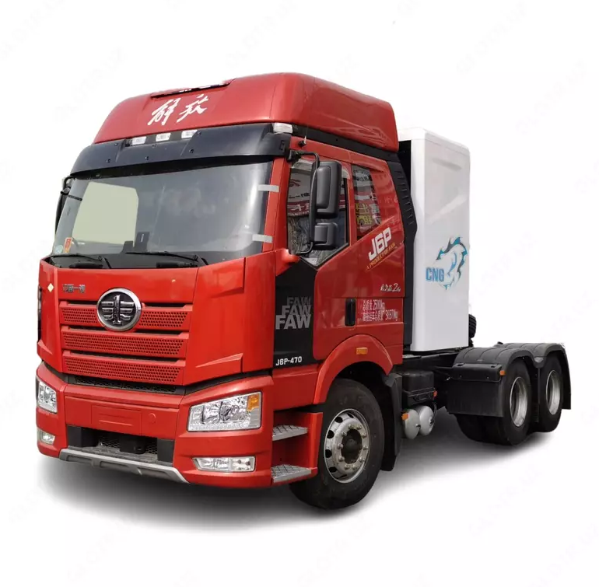

Comparison of leasing cost of FAW J6P tractor unit in 2024 and 2025
1
The marketing agency NAPI analyzed the leasing cost of FAW J6P tractor unit in November 2024 and August 2025 using the online DV – TCO total cost of ownership calculator.
Over 10 months, the average cost of FAW J6P tractor unit decreased by 2.1 million rubles. At the same time, the average rate under the leasing contract fell from 32% to 24%. As a result, the monthly payment was down by 21 thousand rubles, contract expenses - by 4.1 million rubles, and the transaction appreciation - by 15%.
Thus, purchasing of FAW J6P tractor unit on lease this year has become more profitable than it was in 2024.
DV-TCO online calculator calculates the total cost of ownership of trucks, light commercial vehicles, and cars
www.napinfo.ru
Source: NAPI / National Industrial Information Agency

